Slide 1

Geometry
Unit 10, Lesson 5 Solving Problems Involving Arc Measure and Central Angles Volume 2, pg. 141

Slide 2


Benchmark
MA.912.GR.6.2
Solve mathematical and real-world problems involving the measures of arcs and related angles.
volume 2, pg. 141

Slide 3
Integrated Mathematical Thinking and Reasoning Standards
MA.K12.MTR.1.1 Actively participate in effortful learning both individually and collectively.
MA.K12.MTR.2.1 Demonstrate understanding by representing problems in multiple ways.
MA.K12.MTR.4.1 Engage in discussions that reflect on the mathematical thinking of self and others.
MA.K12.MTR.5.1 Use patterns and structure to help understand and connect mathematical concepts.
MA.K12.MTR.6.1 Assess the reasonableness of solutions.
volume 2, pg. 141

Slide 4

Learning Target
I can use the relationship between the measure of a central angle and its intercepted arc to solve problems.
volume 2, pg. 141

Slide 5

Warm-Up
volume 2, pg. 141

Slide 6
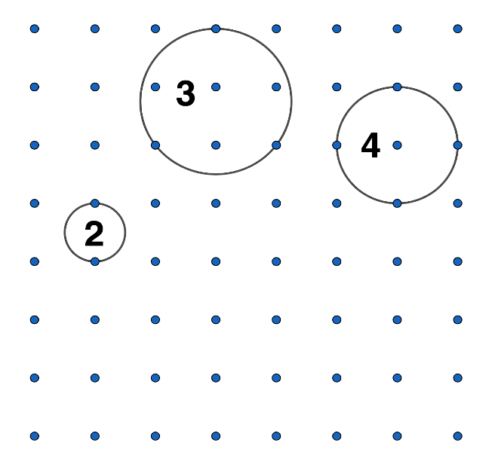
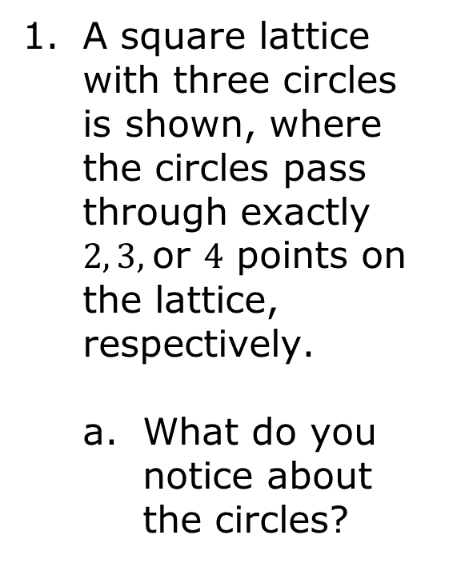
10.5.1 Warm-Up: Circles
volume 2, pg. 141

Slide 7
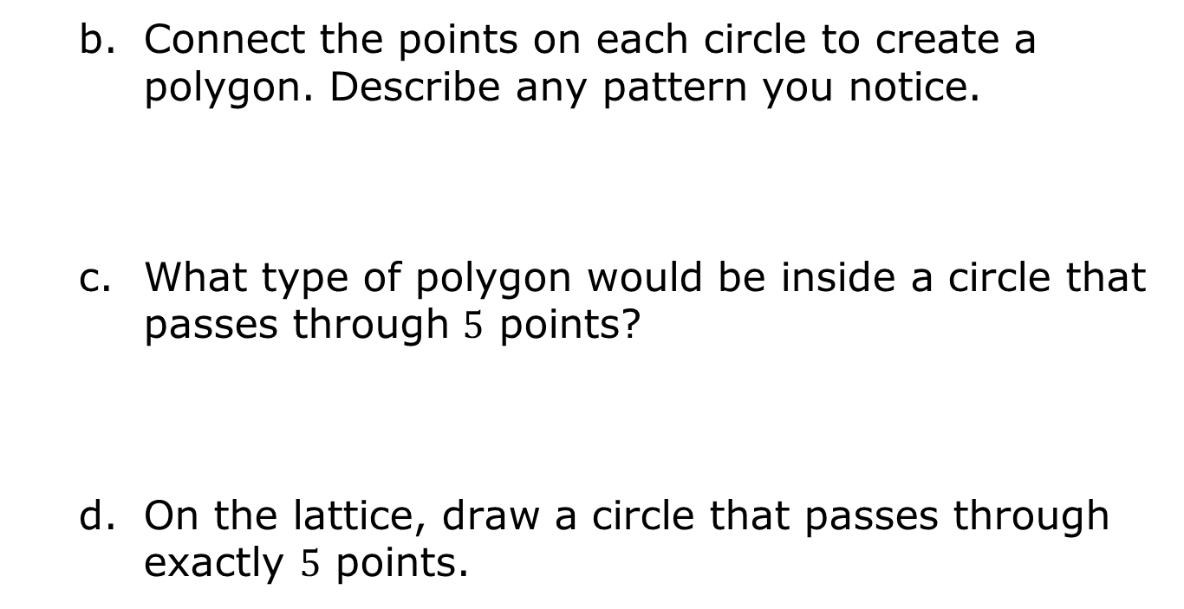
volume 2, pg. 141

Slide 8

Exploration
volume 2, pg. 142

Slide 9

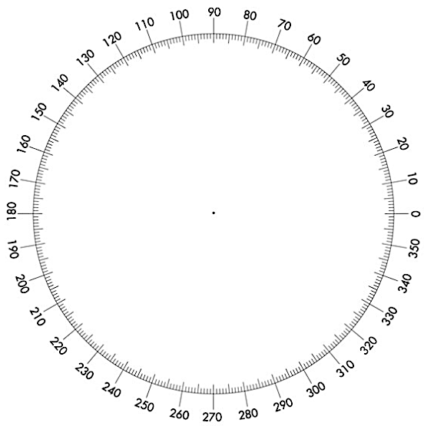
10.5.2 Exploration: Understanding Central Angles
B
volume 2, pg. 142

Slide 10
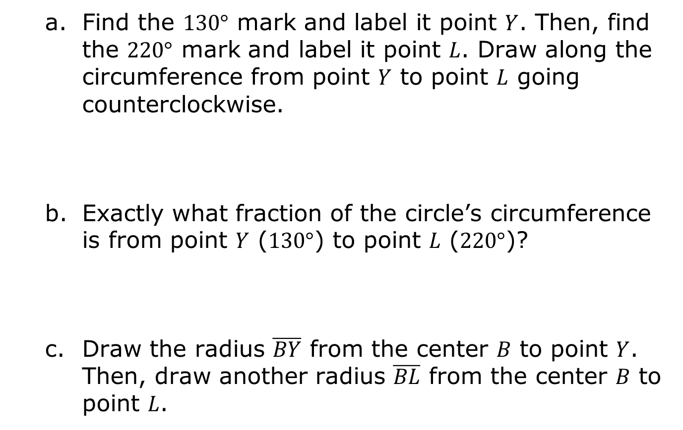
volume 2, pg. 142

Slide 11
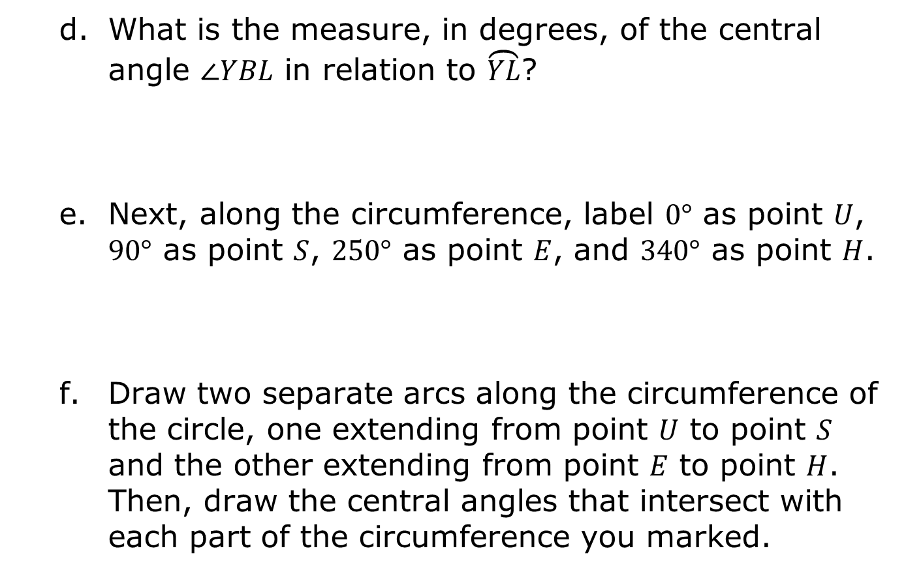
volume 2, pg. 142

Slide 12
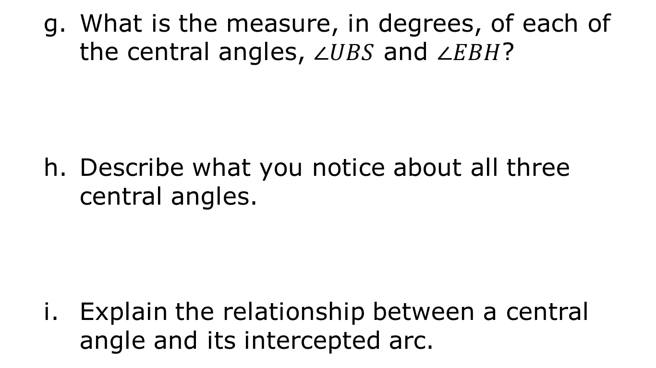
volume 2, pg. 142

Slide 13
Share your response with your partner. Listen to your partner’s explanation and write a summary of the explanation. Have your partner initial stating that your summary of their explanation is accurate.
k. Draw a diagram that shows the relationship between a central angle and its intercepted arc.
l. Discuss with your partner how arc measure relates to the relationship between a central angle and its intercepted arc. Summarize your discussion.
Your Partner’s Explanation | Partner’s Initials
volume 2, pg. 143

Slide 14
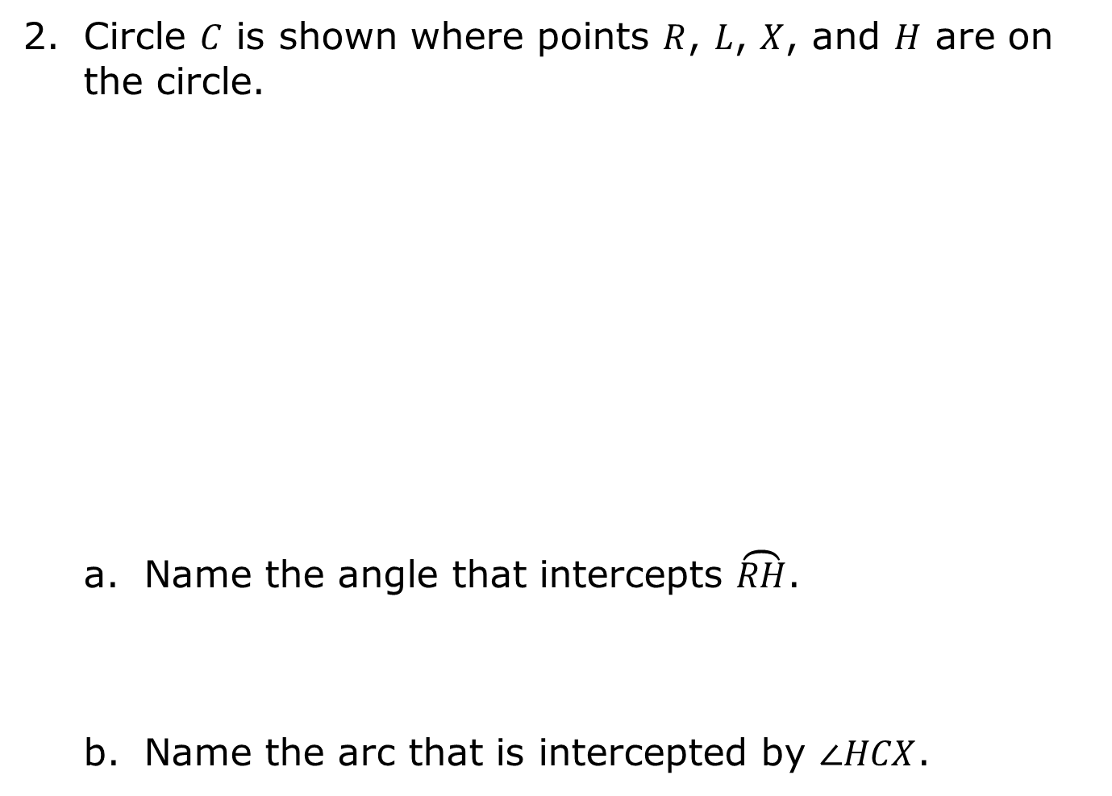
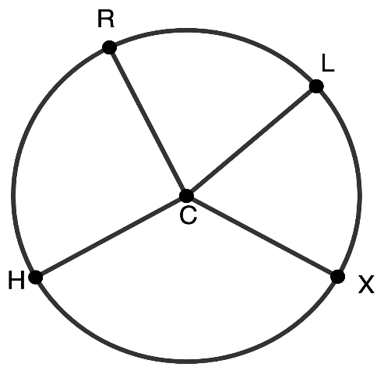
volume 2, pg. 143

Slide 15
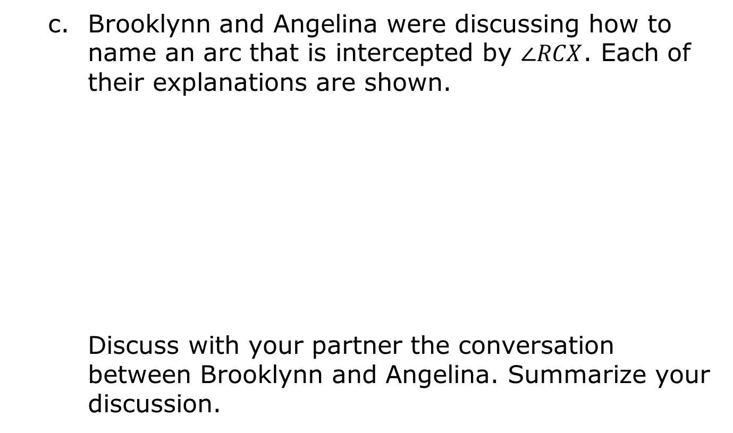
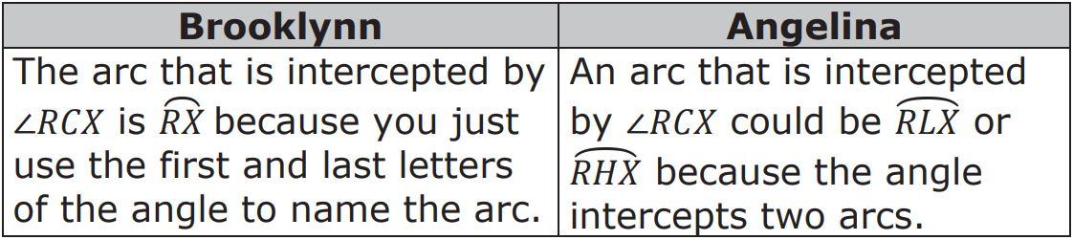
volume 2, pg. 144

Slide 16

Bring It Together
volume 2, pg. 144

Slide 17


10.5.3 Bring It Together: Arc Measure and Central Angles
An arc of a circle is a section of the circumference of the circle.
The length of an arc is simply the length of the section of the circumference.
In a circle, the measure of an arc (in degrees or radians) is equal to the measure of the central angle that intercepts the arc.
volume 2, pg. 144

Slide 18
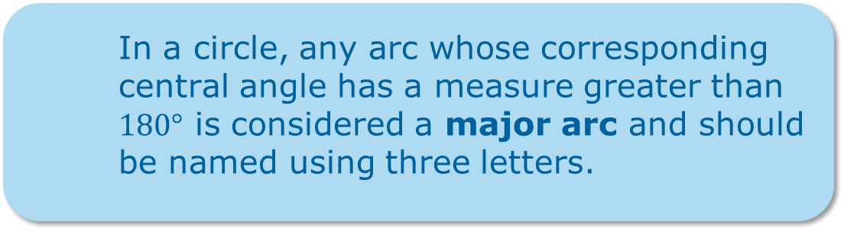
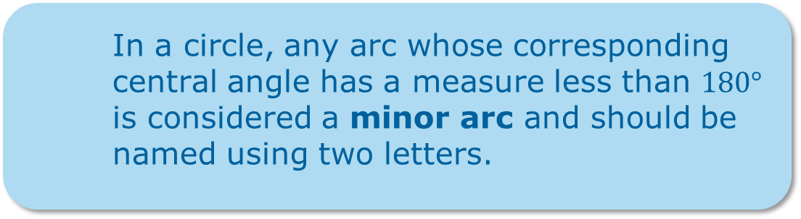
volume 2, pg. 144

Slide 19
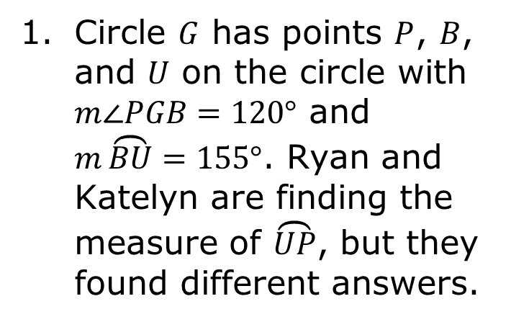
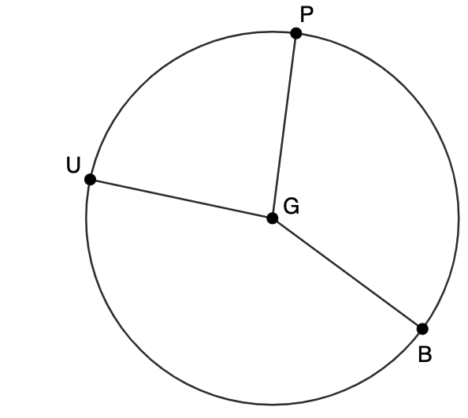
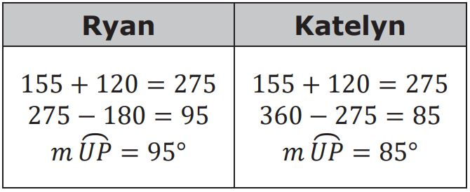
Do you agree with Ryan or Katelyn? Justify your answer.
volume 2, pg. 145

Slide 20

Guided Practice
volume 2, pg. 145

Slide 21

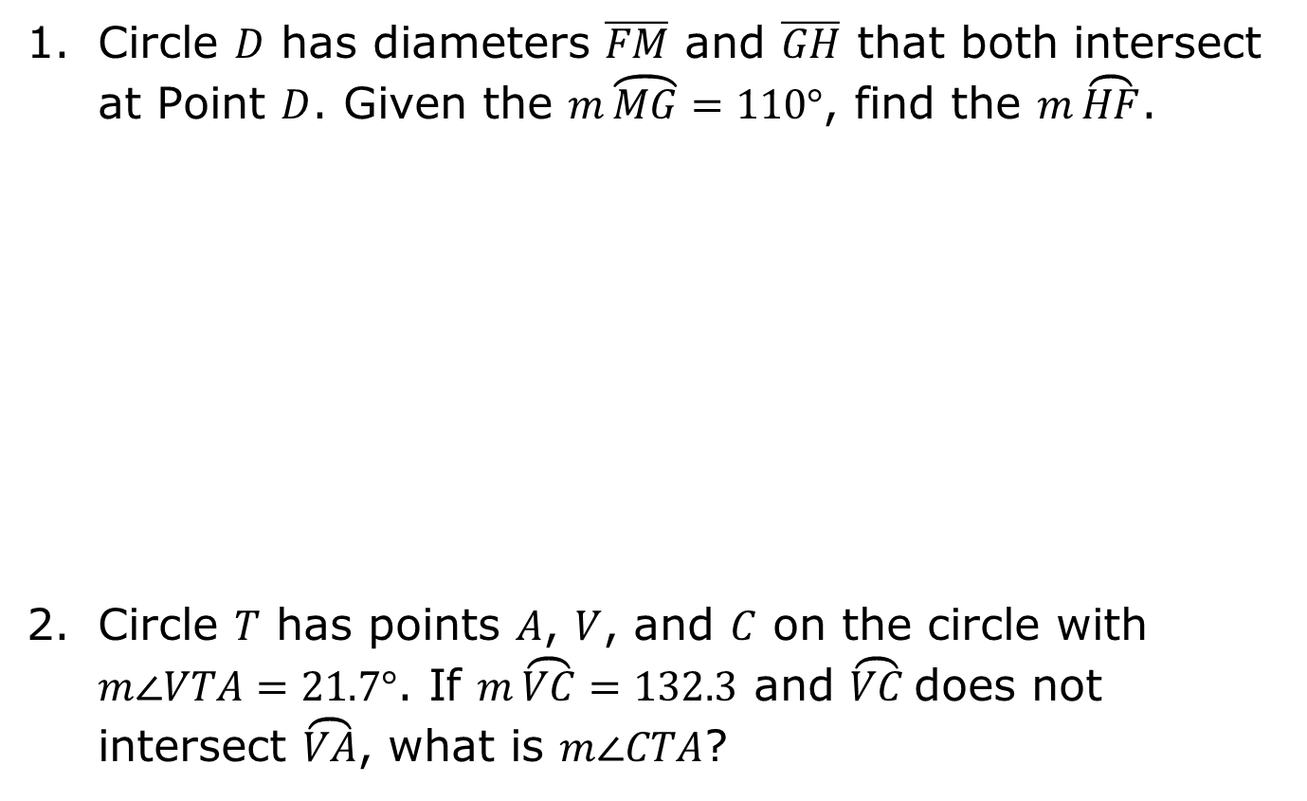
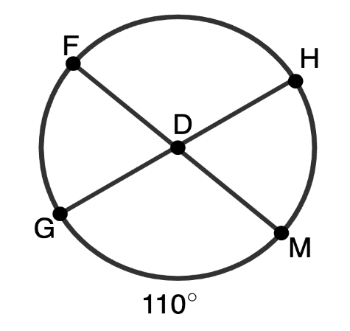
10.5.4 Guided Practice: Finding Angle Measures
volume 2, pg. 145

Slide 22
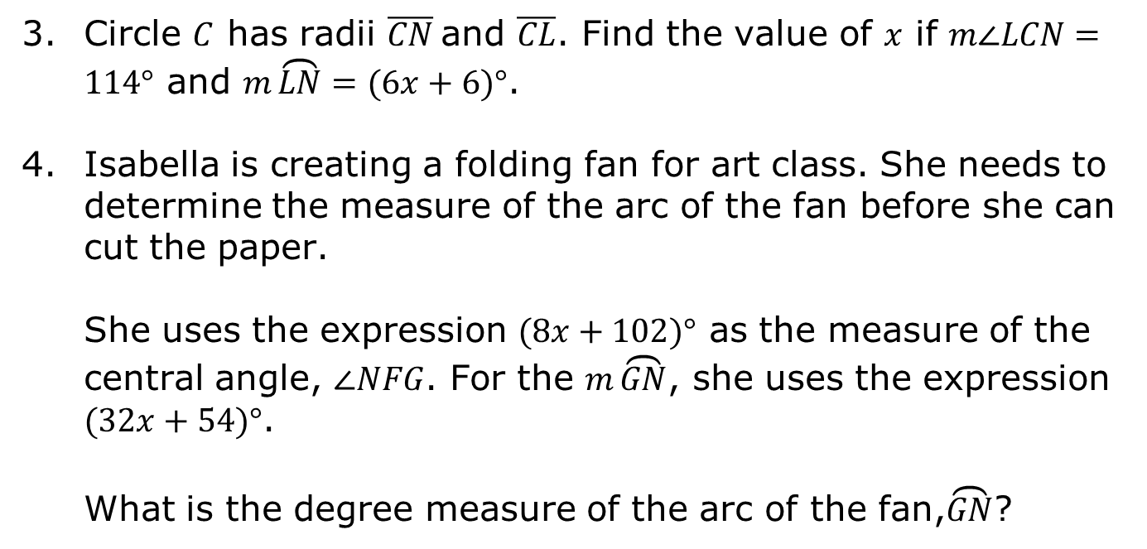
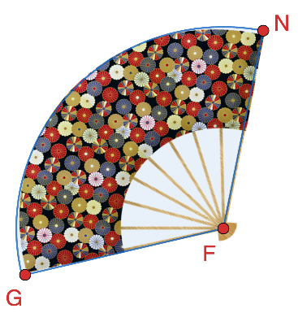
volume 2, pg. 146

Slide 23

Your Turn
volume 2, pg. 146

Slide 24
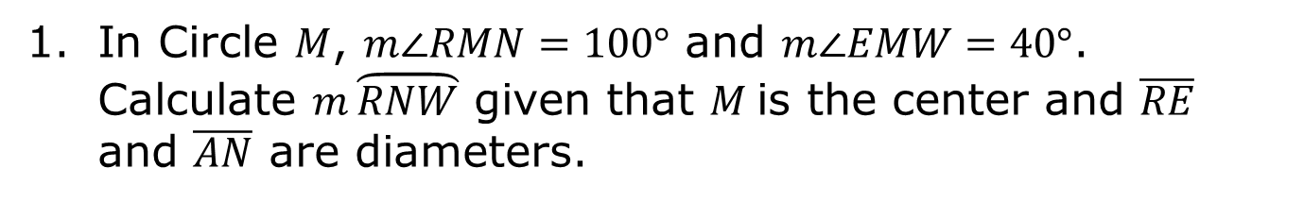
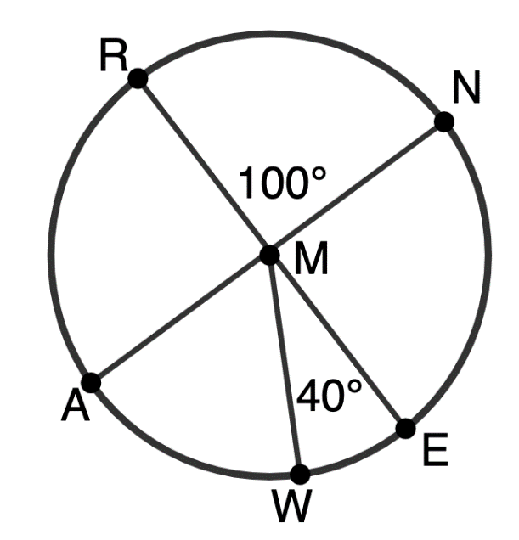
10.5.5 Your Turn!
volume 2, pg. 146

Slide 25
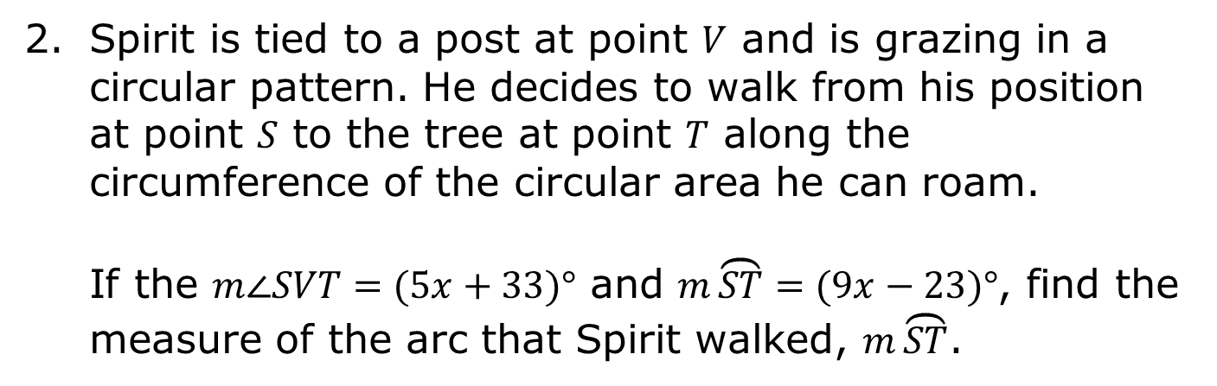
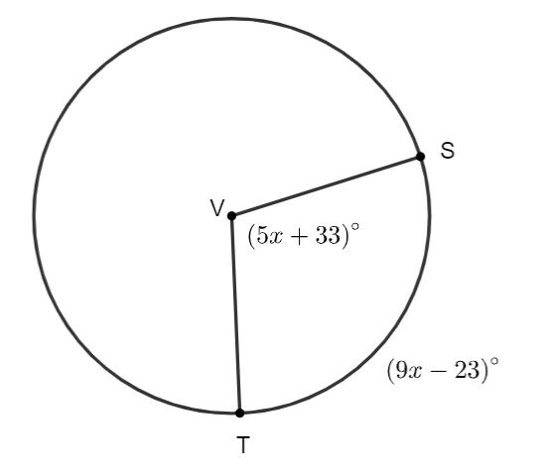


volume 2, pg. 147

Slide 26

Wrap-Up
volume 2, pg. 147

Slide 27
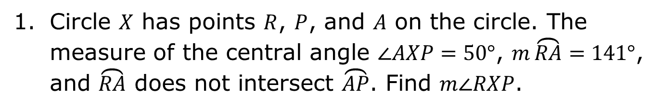
10.5.6 Wrap-Up: Ticket Out the Door
volume 2, pg. 147

